Slide 1
Genes - Genetics
By Mrs. Smith

Slide 2
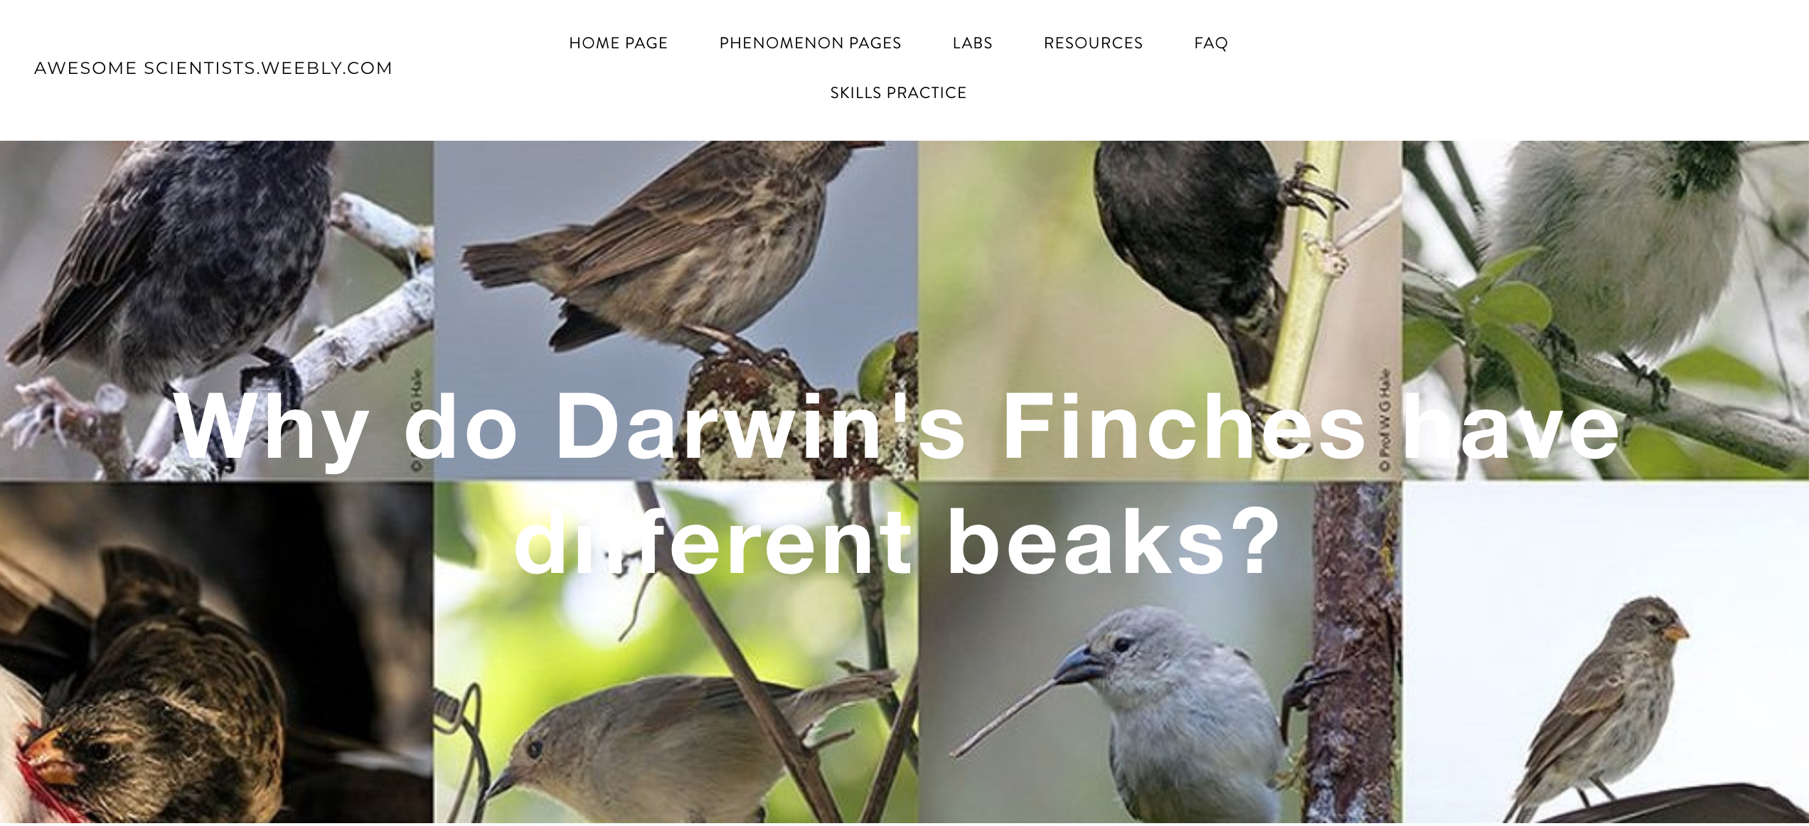
New phenomenon: “Why does Darwin’s Finches all have different beaks?”
Initial Answer:
Go to our new phenomenon page and fill out the Initial Answer Form.

Slide 3
Genes, DNA, Chromosomes
TAKE NOTES ON:
Write down the definitions of Genes, DNA, and Chromosomes
Write down where our Chromosomes are found
Write down any other information that will help you remember what Genes, DNA, and Chromosomes are

Slide 4
Genes, DNA, Chromosomes
TAKE NOTES ON: Add information to what you have already recorded about GENES, DNA, and Chromosomes

Slide 5
Gregor mendel
TAKE NOTES ON:
Who is Gregor Mendel?
Write down a definition for a Dominant Trait
Write down a definition for a Recessive Trait
Write down the definition for an Alleles
Write down the definition for Homozygous
Write down the definition for Heterozygous
Write down the definition for Phenotype
Write down the definition for Genotype

Slide 6
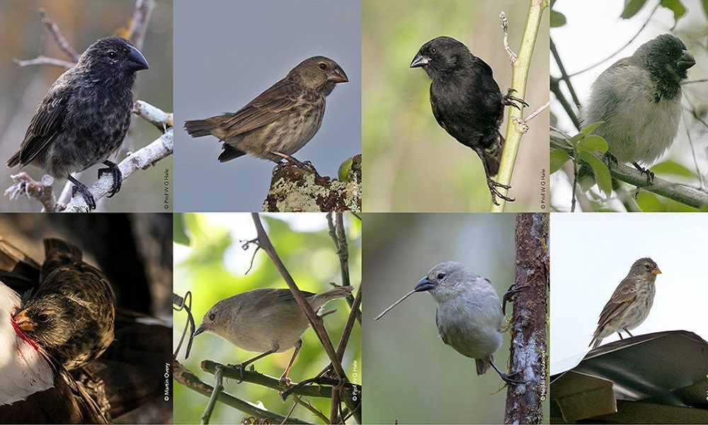
Assignment:
Finish up your Initial Answer! on our new Phenomenon Page “Why Does Darwin’s Finches All Have Different Beaks?” for Monday.

