Slide 1
Genes - Mutations
By Mrs. Smith

Slide 2
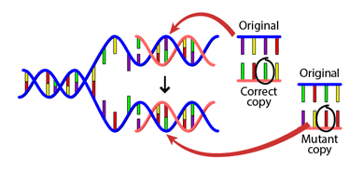
Mutations
Mutations are changes in the sequences of DNA, simply meaning that one or more of the amino acids in the DNA is copied in correctly
Mutations can be inherited
Mutations can also come from the environment

Slide 3
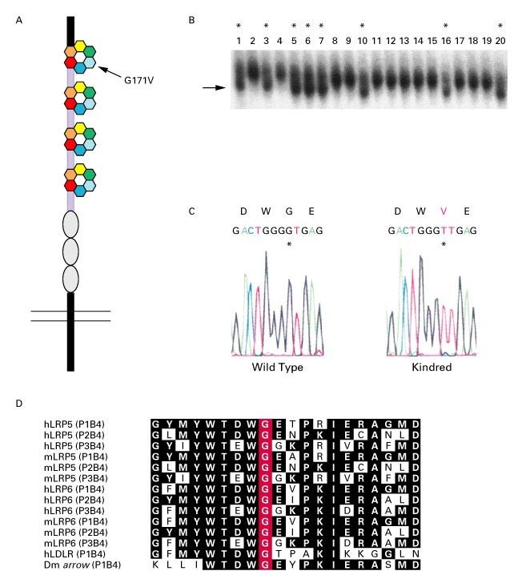
Mutations can be beneficial
EXAMPLE : Increased bone density “unbreakable bones” due to a substitution of amino acid in the DNA

Slide 4
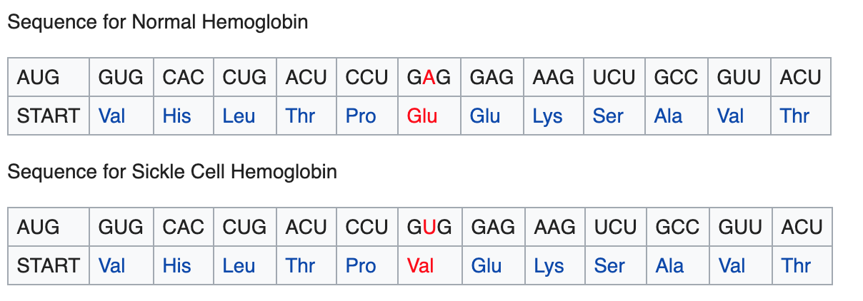
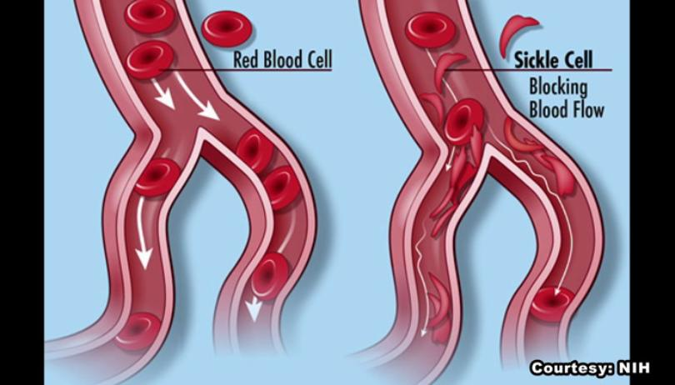
Mutations can be harmful
EXAMPLE: Sickle Cell is caused by a substituted amino acid in the DNA sequence, changes the shape of the red blood cell

Slide 5
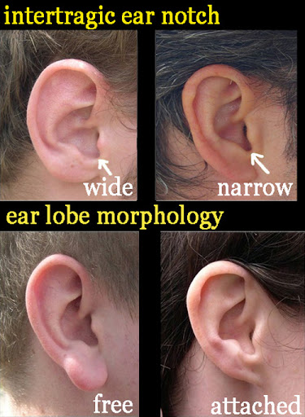
Mutations can be neutral, neither beneficial nor harmful
Neutral Mutations are changes in DNA sequence that are neither beneficial nor detrimental to the ability of an organism to survive and reproduce. MOST MUTATIONS ARE NEUTRAL

